Slide 1
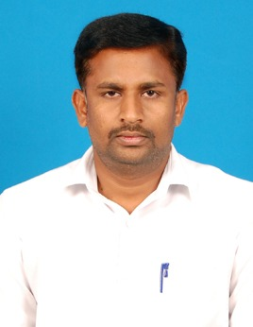
NIRMALA COLLEGE FOR WOMEN
(AUTONOMOUS)
Accredited with ‘A⁺⁺' Grade by NAAC in the IV Cycle with CGPA 3.78
Red Fields, Coimbatore – 641 018.
Rethink Redefine Reform
PG and Research Department of Chemistry
Organizes
Workshop on
MEASUREMENT OF SUSCEPTIBILITY OF SOLIDS BY GOUYS BALANCE METHOD
Date: 19.12.2023
Resource Person
Dr.G.Ayyannan
Assistant Professor
Department of Chemistry
Sri Ramakrishna Mission Vidyalaya
College of Arts and Science
Coimbatore - 20
Chief Patron
Rev. Sr. Dr. Kulandai Therese
Secretary
Patron
Rev. Sr. Dr. Mary Fabiola
Principal
Convener
Dr. N.Gunavathy
Assistant Professor and Head
Organizer
Dr. P. Kalaivani
Assistant Professor of Chemistry
Faculty Members
Dr. C. Subha
Dr. Sr. S. Kulandai Therese
Dr.P.Dhivya
Dr.K.Anbarasi
Dr. J.Johncy Caroline
Mrs. S. Valli
Mrs. J. Antonette Luciana Sherynn
All are Cordially Invited !

